Slide 1

Multivendor Ecommerce
Development Proposal
www.HathorUnion.com

Slide 2
Digital Empowerment Agenda
1
Overview
6
Scope
11
Deliverables
Digital Suite Introduction & Organizational Goals Brief
Client goals, audiences, brainstorming, met deadlines, and ideas realized with reviews.
Development timeline outline with milestones and key deliverables.
2
Our Digital Suite
7
Technology Suggestions
12
Requirement Checklist
Services & Integrations
Proposed technologies, with rationale for strategic choices
App development yields code, designs, documentation, and deployed features.
3
Capabilities
8
Features
13
Service offering
At Hathor Union, agile teams deploy tailored solutions, showcasing teamwork and tech expertise.
In-depth exploration of key features, highlighting user benefits and advantages
Overview and confirmation of project requirements alignment.
4
Our Understanding
9
Hosting
14
Our Process
Market Trends Insights & Customer Needs/Expectations
Discussion on hosting options, exploring
providers.
App development involves designing, coding, and launching.
5
Approach & Methodology
10
Empowering Digital Presence
15
Costing
Development Methodology Explanation
User-Centric Design Emphasis
We enhance app visibility with optimized development and impactful marketing strategies.
We enhance online presence with optimized sites and impactful campaigns.
www.HathorUnion.com

Slide 3


Overview
Hathor Union Brand stands as a cutting-edge, innovation-driven firm dedicated to delivering top-notch app development services and digital solutions to forward-thinking companies globally. At Hathor Union Brand, we take immense pride in our comprehensive, proactive, and pioneering approach. Our proficiency lies in crafting mobile experiences that seamlessly blend aesthetics with functionality.
In the realm of app development, Hathor Union Brand goes beyond the conventional by providing cutting-edge app solutions. Our app development services add an extra layer of innovation and efficiency to our comprehensive suite of offerings. This advanced service is designed to create user-friendly and feature-rich applications, propelling your business into the future of mobile technologies.
Furthermore, Hathor Union Brand brings a wealth of expertise to the forefront in the field of app development. With specialized professionals in every department, we offer an integrated approach to your app development and marketing needs. From strategic planning to monthly reporting, Hathor Union Brand ensures that you consistently achieve optimal results in app development. Immersed in the digital realm, we continually innovate to push boundaries and enhance your mobile presence, solidifying Hathor Union Brand as your trusted partner in app development and technological advancement.
Why us
Contribution
With a demonstrated history of developing digital solutions across more than 20+ domains and successfully executing over 50+ global projects, Hathor Union emerges as the optimal partner for your digital pursuits.
100000+ lines of code written
1000+ hours of design & UXUI
2000+ hours of product research
4000+ hours of digital work
www.HathorUnion.com

Slide 4













Our Digital Suite
Digital strategy
UI UX & web
App development
Search marketing
Strategy & Consulting
Front end & Web dev
Software development
SEO,PPC, & Outreach
Product experience
Data & AI
Ads & campaigns
Brand & creative
Product design
Data related development
Paid media and ads
Brand Design & comms
Our experts are certified with

Slide 5







































Capabilities
At Hathor Union, our elite custom web development teams are meticulously assembled, meticulously selecting top-tier talent from a pool of hundreds of applicants for each technology position. Collaborating within dynamic and creatively designed workspaces, we cultivate an environment that encourages continuous learning and embraces mutual challenges. Operating with agility, our lean teams efficiently deploy bespoke solutions tailored to meet the unique needs of each client.
Team strength 25+
Business analysts
UX UI engineers
Python/ Rubyonrails / Opensource
Automation / Solution architects
Product architects
Full stack app developers
Product/Project managers
Design experts
Marketing Analyst
AI/ML/Blockchain Dev
Data experts
Digital Transformer
The below mentioned are our technology expertise...
And More +

Slide 6


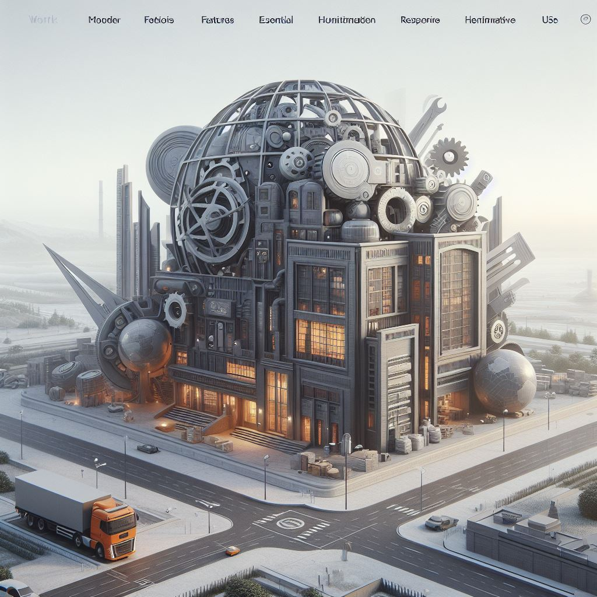
Our Understanding
Collaboratively crafting an innovative mobile app tailored for the Hathor Union brand.
Develop a modern, minimalistic, and responsive UI for Hathor Union's mobile application.
Inclusion of essential features and advanced functionality in the app design.
Implementation of an easy-to-navigate interface for seamless user experience.
Ensure close collaboration with the client's team throughout the app development process.
Create a mobile application that authentically represents the key values and aspirations of our esteemed client, Hathor Union.
#
Reliable Trust
Trust
Credibility
People centric
Affordable
Reliability
Quality
Innovation

Slide 7
Approach & Methodology
1
2
Design & Development Nexus
BRAINSTORM/ EXPLORATION
Uncover the A-ha! Factor through creative ideation.
DEFINE APP OBJECTIVES
Clearly outline client goals and target audiences.
Innovation Sprint
4
3
Launchpad
Execution Excellence
TIMELY DELIVERY
Meet deadlines to ensure the successful accomplishment of project objectives.
BRING IDEAS TO LIFE
Execute ideas and seek client reviews for refinement.

Slide 8
Scope
The Hathor Union App Development Scope entails a holistic approach, commencing with a thorough project overview that aligns with Hathor Union's objectives and target audience. We will meticulously incorporate client-specific requirements, emphasizing a balance between essential functionalities and innovative design elements. Our technology stack will be thoughtfully chosen to ensure efficiency and scalability. The development timeline will outline key milestones, promoting timely delivery, and client involvement will be actively encouraged throughout the process. Rigorous testing, strategic deployment, and a robust post-launch support plan will ensure a seamless app experience. The scope also encompasses a transparent budget breakdown, resource allocation, and risk management strategies, creating a collaborative framework for successful app development.
Our Process
2
Market
Research
4
Design Phase
6
Testing
10
Marketing and Promotion
8
Post-Launch Support
Planning and Strategy
3
Development
5
Maintenance and Updates
9
Idea
Conceptualization
1
Deployment
7

Slide 9












Technology Suggestion
At Hathor Union, our dedicated team actively engages with clients, providing tailored technology recommendations specifically focused on optimizing their app development endeavors. Through strategic insights, we empower clients to embrace state-of-the-art technologies, not only meeting their immediate app requirements but also positioning them for sustainable growth. Fostering a collaborative environment, we guide informed decision-making, allowing clients to harness the latest advancements for enhanced app efficiency, functionality, and a competitive edge in the dynamic landscape of app development.
UX UI Design
FRONT END CODE BASE
BACKEND CODE BASE
DATABASE MANAGEMENT SYSTEM

Slide 10
Application Additional Features Plans
AI Chatbot Integration (Knowledge Base)
Vendor Performance Report
Vendor Storefront (Sub-Domain or self)
Vendor Promotion Request Module
Vendor - Customer Journey Tracking
Vendor or Supplier Connections
Live Customer Support (24*7)
Customers cart abandonment updates
Product Shoutouts (For C2B)
Vendor Invoicing Module
Smart Notifications
Affiliate Program module
In-Chat Product Purchase
Predictive Analytics
Auto Vendor and Admin Reports & Recommendations
Vendor Recommendations
Dedicated FTE
(Frontend, Backend, Testing, Cloud, Design,
Customer Support, Marketing)
Auto SEO for all products and Storefronts

Slide 11






Hosting
At Hathor Union, we take pride in offering direct hosting services for app development. Our dedicated hosting solutions are designed to meet the specific needs of app development projects. Clients can rely on our in-house hosting infrastructure, which ensures a seamless and secure environment for their applications. We understand the criticality of hosting in the app development process and provide comprehensive services, including Network Management, Managed Backup, Managed Firewall, OS Hardening, Patches & Updates, Proactive Monitoring, Staging Environment, and more. Our commitment is to deliver a reliable and well-maintained hosting platform, backed by our expertise, to support the success of our clients' app development endeavors.
Some of the popular hosting providers we recommend

Slide 12

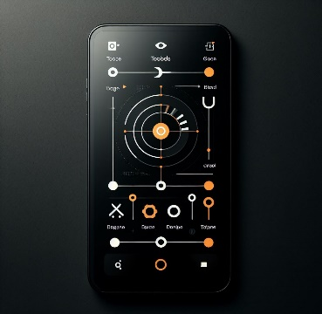



Empowering Digital Presence:
Impactful Digital Experiences
Cross-Platform App Development
Robust Backend Solutions
E-commerce Solutions
Cloud Integration and Scalability
At Hathor Union, we specialize in creating innovative and engaging user interfaces that seamlessly adapt across devices. Our app development service is dedicated to making your digital presence visually stunning and impactful.
We excel in cross-platform app development using React Native and swift. We enable clients to target both iOS and Android simultaneously, ensuring efficient, cost-effective solutions with a consistent user experience across devices.
We ensure a robust digital foundation with powerful backend development. We implement scalable server architecture, efficient databases, and secure APIs, prioritizing performance, scalability, and data integrity for seamless web and mobile app functionality.
We craft tailored
e-commerce solutions, integrating secure payment gateways, optimizing product catalogs, and ensuring a smooth checkout process. With a focus on user experience and security, we empower businesses to thrive in the digital marketplace.
We ensure scalable and cost-effective app hosting by seamlessly integrating with popular cloud platforms. Embrace performance and reliability for your digital business.

Slide 13
Deliverables
Milestone 1
Milestone 2
Milestone 3
Milestone 4
Milestone 5
Research
Design
Development
Go Live
After Live
In the Research phase of app development, Hathor Union conducts a comprehensive analysis of client requirements, industry trends, and target audience, establishing the groundwork for success by gathering essential information and insights
The Development phase focuses on translating gathered insights into a functional and user-friendly mobile app. This includes tasks such as wireframing, developing prototypes, and creating beta versions for client review and approval.
The Development milestone transforms the approved app design into a fully functional product through coding and programming. This phase includes implementing interactive features, integrating content, and ensuring the app's responsiveness across various devices.
The final milestone, App Launch, signifies the official release of the mobile application. It includes deploying the app to live servers, validating seamless functionality, and equipping the client with tools for ongoing app management
Hathor Union's commitment extends beyond the app release, offering continuous support, maintenance, and opportunities for content revision. This ensures sustained optimal app performance and responsiveness to evolving needs
Deliverables:
Deliverables:
Deliverables:
Deliverables:
Deliverables:
Requirements analysis
Client insights report
Industry trends summary
Wireframes for app interface
Interactive app prototypes
Client-approved app design mockups
Functional app features
Integrated app content
Cross-device responsive app
Deployed mobile application on live servers
Verified seamless functionality of all app features
Client-provided tools for ongoing app management
Ongoing app support and assistance
Regular app maintenance services
Opportunities for content updates and revisions

Slide 14

Requirement checklist :
Briefly describe app purpose, goals, and target audience.
Specify target platforms (iOS, Android, web) and device preferences.
List features and prioritize based on importance.
Share design elements and preferences for app appearance.
Provide text, media, integration details, and access credentials.
Specify security measures, compliance, and UX expectations.
Describe testing, budget constraints, and desired timeline.
Include feedback channels, legal considerations, and additional insights like scalability, monetization, support, prototypes, competitor info, and analytics.

Slide 15
Our Process
For Mobile app development
8
Marketing and
Promotion
Develop a marketing strategy, create promotional materials, and implement user acquisition and retention tactics
Marketing and Promotion
7
Maintenance and Updates
Regularly maintain the app, fix bugs, and release updates with new features or improvements
Maintenance and Updates
6
Monitor app performance, address user feedback, and provide ongoing support. Implement updates as needed.
Post-Launch Support
Post-Launch Support
5
Deployment
Prepare the app for release, finalize configurations, and deploy to app stores or servers.
Deployment
4
Conduct thorough testing, including functional, usability, and performances testing. Address any identified issues.
Testing
Testing
3
Write code, implement features, and integrate third-party services. Regularly test and debug during development
Development
Development
2
Create wireframes, prototypes, and UI/UX designs. Gather client feedback for revisions.
Design Phase
Design Phase
1
Define project objectives, target audience, and key features. Develop a project roadmap and set milestones.
Discovery & Planning
Discovery & Planning

Slide 16
Launch excellence, sustain brilliance. Ongoing support, maintenance, and content.
Your App always at its best
support@HathorUnion.com
www.HathorUnion.com

